Slide 1
Bubble Sort and Insertion Sort Implementation in Python
By Ar kar Nyan Hein

Slide 2
Lesson Objective
By the end of this lesson
Review on stack algorithm
You will be able to visualize how bubble sort and insertion sort work
Implement insertion, bubble sort in python
Run the function of insertion sort and bubble sort

Slide 3
Bubble Sort
Two arrays are swapped each time in the set indexed, smaller one go to the left and the lower value go to right in the ascending order.
Opposite is true at descending order.
Two implement bubble sort, we need two for-loops in the form of nested for loop. (I and j).
i represent the total elements in the set which we are sorting. Once the element is sorted correctly i pointer will be reduced by 1.

Slide 4
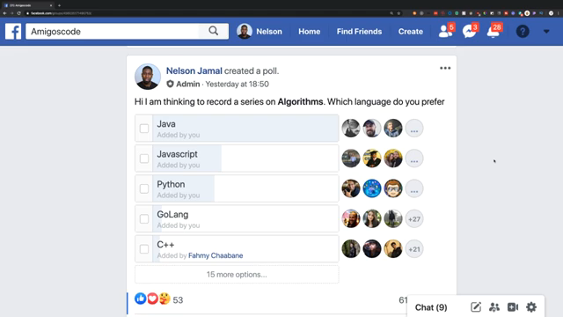
Bubble Sort Quick Visualization

Slide 5
Insertion Sort
You only need total number of elements in the index to be sorted.
You don’t need know how many times you have to sort again like bubble.
Difference is bubble sort can still leave the elements incorrectly sorted. Whereas, insertion sort, sorted until everything is correct.

